Slide 1
Quality by Design
Connectivity Insights

Slide 2

Current ConnectivityInsights APIs
Connectivity Insights focuses on app sending requirements to Network Operator to find out whether or not the network can support them.
Packet Loss
Latency
Jitter
Bitrate
Network Operator Replies with yes/no (can we meet these requirements). With more transient network situations like on mobile, this works well for an app to know if it will be able to perform.
QualityByDesign takes this a step further and has the application send it’s KPIs to the network operator for analysis.

Slide 3
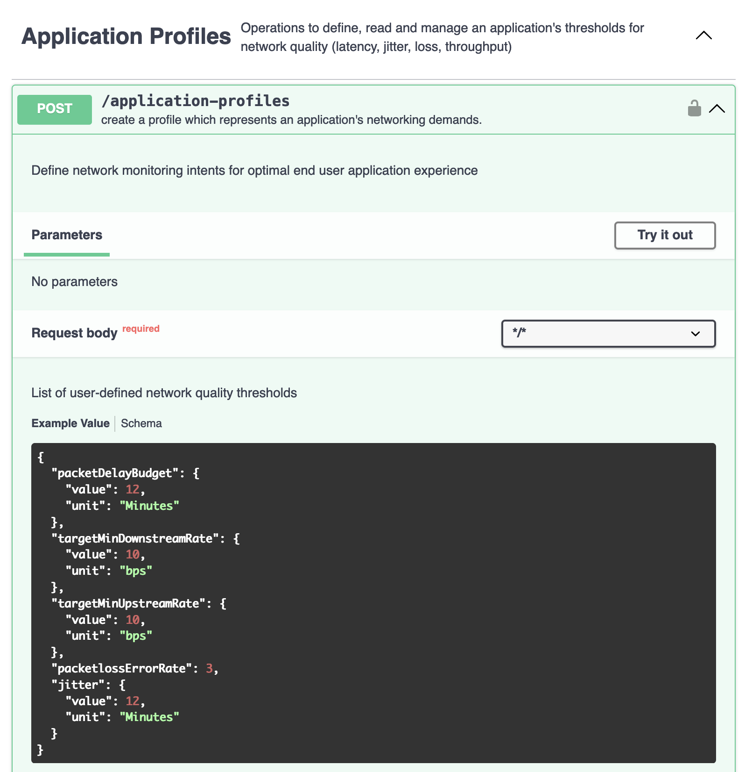
Re-using ConnectivityInsights application-profile
ConnectivityInsights application-profile contains:
Packet loss
Latency
Jitter
Bitrate
QualityByDesign will re-use this application-profile since it matches up with the KPIs that the application will send to the network operator.

Slide 4
New ConnectivityInsights API
Met with CAMARA API Backlog Thursday, 8/8
Pitched two options
  Extend existing ConnectivityInsights
  New QualityByDesign API in the ConnectivityInsights API family
Randy Levensalor(CableLabs), Kevin Smith (Vodafone) supportive of #2
Async response to get score and root cause/recommended actions
  Will use CAMARA cloudevents template
No official decision yet. Kevin wanted to run by Mahesh at next ConnectivityInsights meeting on 8/14
After next Wed’s meeting, will go to TSC for approval. If decision is #2, then new repo would be created once TSC approves

