Slide 1
Call Forwarding Signal
16th of July 2024

Slide 2
LF Antitrust Policies
The LF policies are in the CAMARA project charter. This is sufficient to cover all Sub Projects. There is no need to had them in GitHub or in Confluence.
We can mention them shortly at the beginning of each meeting and we include a sentence in the meeting minutes.
Antitrust Policy - LF Projects, LLC

Slide 3
Agenda
LF Antitrust Policies
Last Meeting Report Approval
Meta Release update
YAML Walkthrough
Test Cases
Next Steps
Action Items

Slide 4
Last Meeting Report Approval
Last meeting minutes to be approved: 2024-07-02 CFS Minutes - CAMARA Project – Confluence
This call minutes (live): 2024-07-16 DRAFT CFS Minutes - CAMARA Project - Confluence

Slide 5
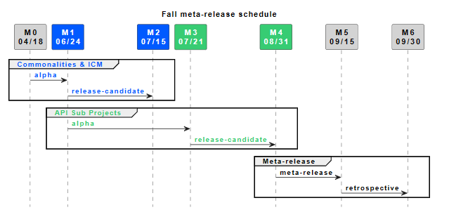
Meta Release
Call Forwarding Signal release as a part of CAMARA Meta-release · camaraproject/CallForwardingSignal · Discussion #38 (github.com)
On the 21st of July the RC must be release for everyone to comment
Feedbacks from CAMARA

Slide 6

YAML Walkthrough
Let’s open the code.

Slide 7
Test Cases
Two “.feature” files
One for each endpoint (Unconditional and Conditional)
Covering “sunny days” and errors

Slide 8
Next Steps
Create Alpha Release
Create RC Release

Slide 9
Action Items
Number | Action | Description | Owner | Status
2-1 | User Story: for UseCase-2 | Create the first User Story for the Telecommunication Frauds use case | Fan Yang | Pending
6-1 | Start Alpha release | Once the API definition is stable, move to Alpha | Fabrizio | Pending
7-1 | YAML and Guidelines | check the YAML against the Guidelines before Alpha | Fabrizio | Complete
7-2 | Test Case and Guidelines | check the Draft Test Case against the "style" adopted in Commonalities | Ludovic | Complete
7-3 | Optional Operation | To implement | Fabrizio | Complete

